Slide 1
Unsupervised Learning Techniques
Clustering and Dimensionality Reduction

Slide 2
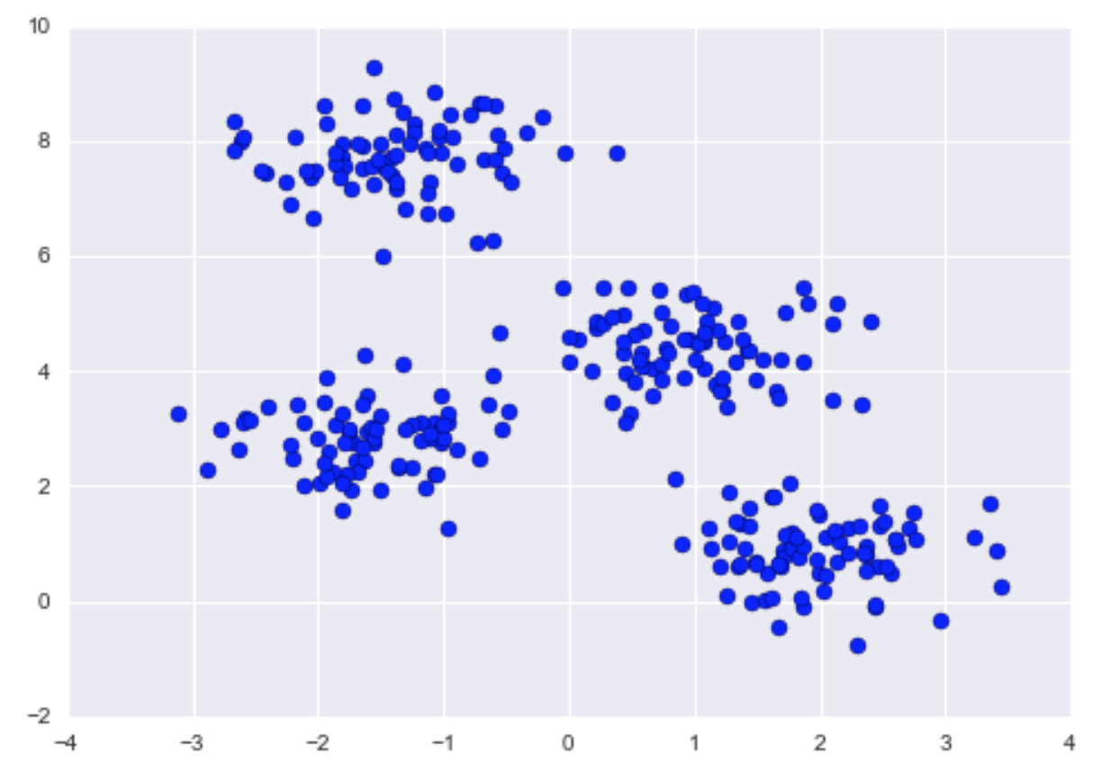
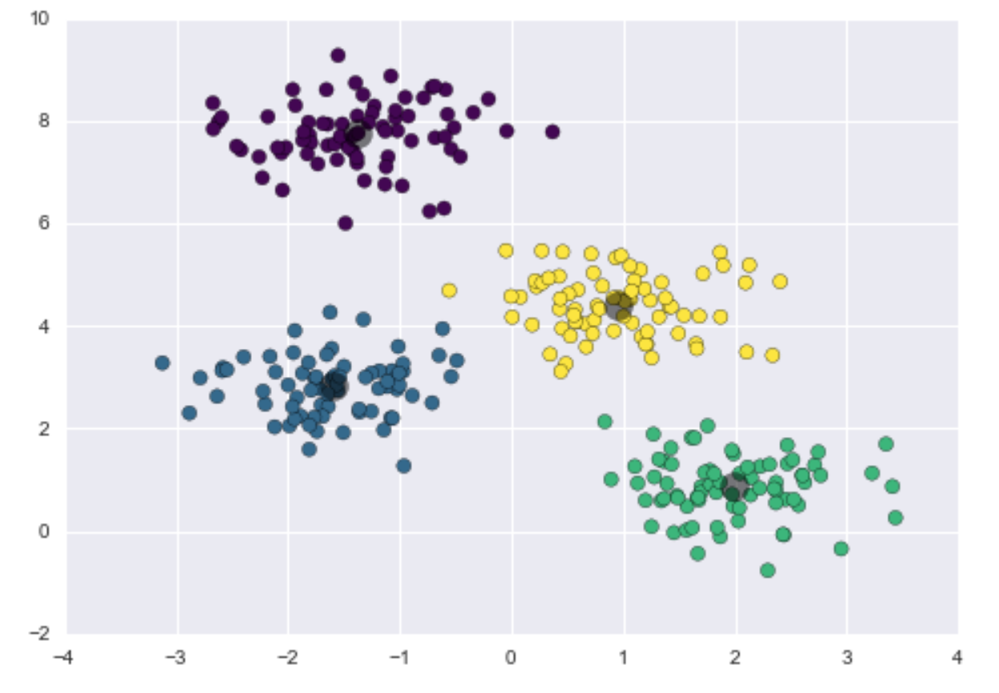
Clustering
Clustering is an unsupervised learning technique.
We DON’T need any label (target values) for clustering. In fact the goal of clustering is infer labels directly from data.
Clustering: create groups (clusters) of samples similar to each others.

Slide 3

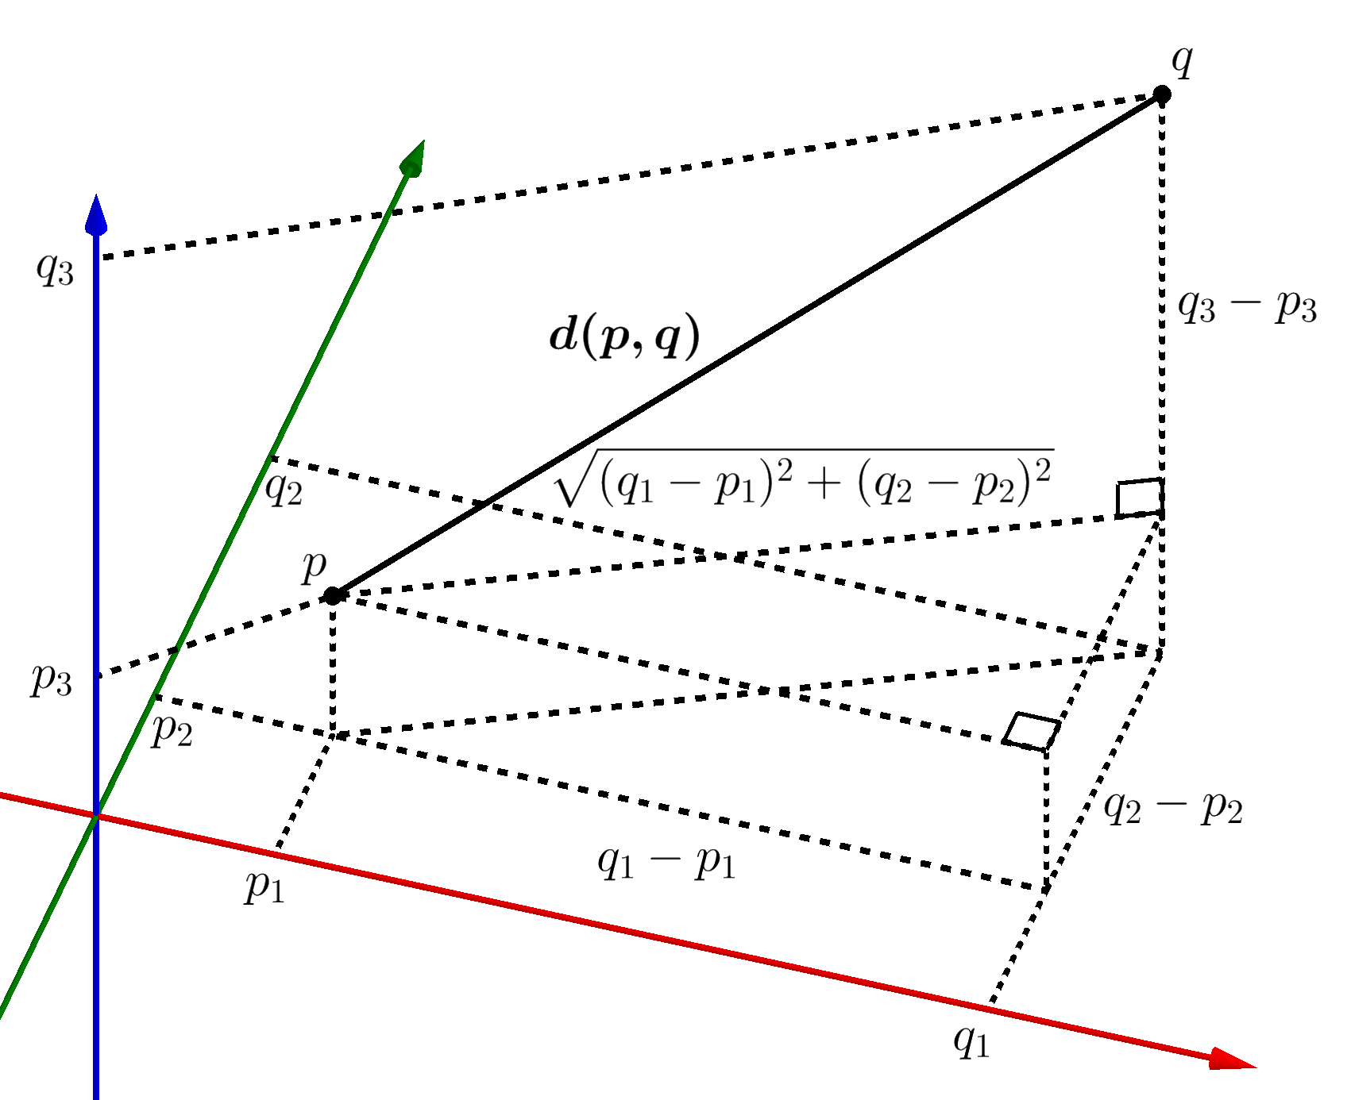
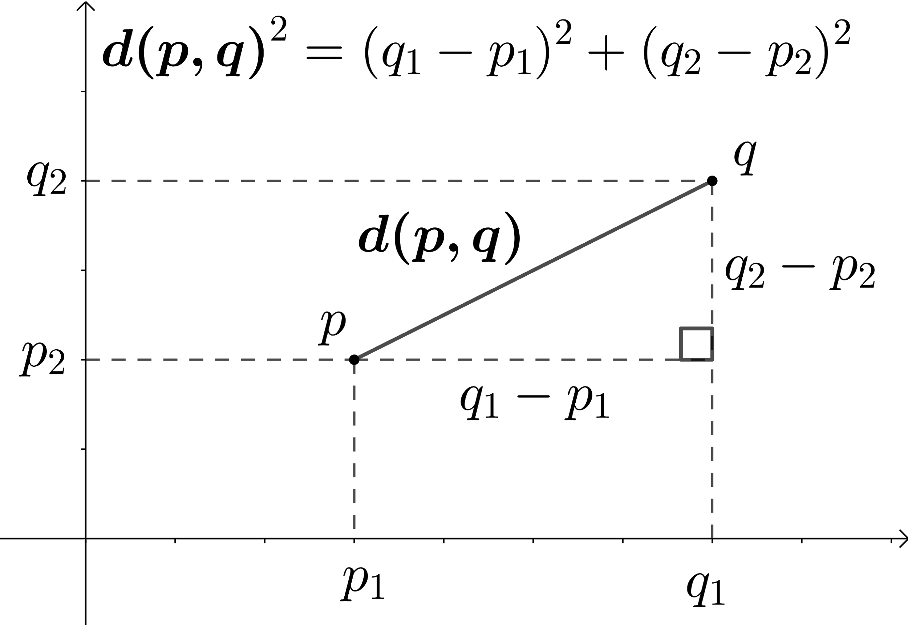
Similarity of sample
What does “similarity” means? When 2 samples are similar? Imagine you are in a 2d space and we have 2 samples (2 vectors) in this space. We need something (a metric) to calculate the distance between them: the more close, the more similar. For example, we could calculate the euclidean distance
Take home message: for clustering, we always need a distance metric able to calculate distances between pair of samples

Slide 4
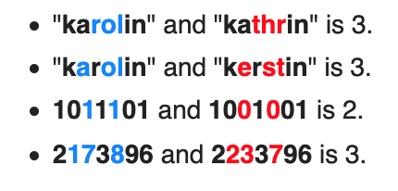
Different distance metrics
There are some common distance metrics (usually used):
Numerical data: Euclidean distance
Categorical data: Hamming Distance (link to wikipedia)
Hamming Distance
It works on samples of the same length, it tells us the number of non-matching elements in the vector
Examples:

Slide 5
K-mean Clustering
This method is simple and it works great on spherical clustering mostly. LINK animation
Steps:
Setting: Decide in advance the number of clusters you want to have (es: num_cluster = 3)
Initialize 3 centroids = random points in the space
For Loop num_iterations:
Get distances: Calculate the distances (e.g. euclidean) of each centroids to ALL samples
Assignment: assign the samples to the closest centroids. Now each sample is assigned to one out of 3 centroids.
Update step: Calculate the mean of the cluster and move the centroid in the means of the clusters
Repeat until convergence
The centroids are points in the space representative of the cluster.

Slide 6
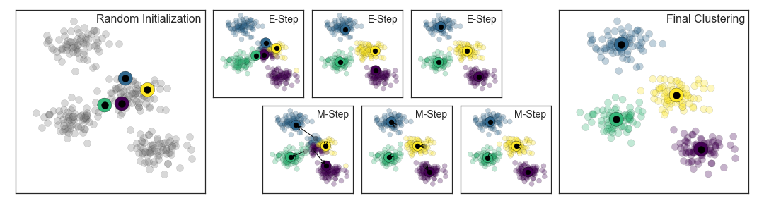
K-mean Clustering
The centroids are points in the space representative of each cluster.

Slide 7
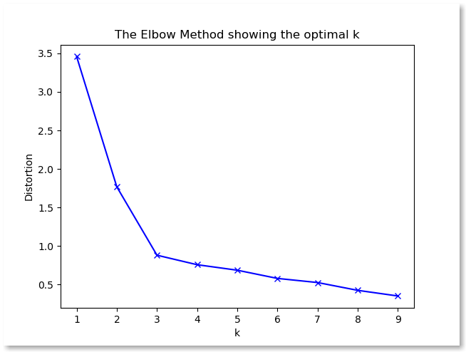
K-mean: how many clusters?
It is easy when we have 2 features. But when we have 100 features (samples living in 100 dimension space) is complicated to scatter plot them and visualise the results.
Here the main question: how many clusters? We can use the Elbow Method
The method is this:
For num_cluster in range(10):
KMeans(cluster = num_cluster).fit(X)
List.append(inertia)
plot(List)
What is inertia?

Slide 8
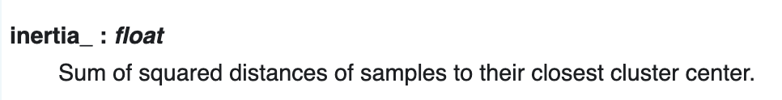
K-mean: Inertia
From Sklearn Documentation: LINK
Intuitively, the inertia is a value that indicate how much the samples are close to their centroids.
Similar to inertia, “distorsion” is very similar to inertia: average distance of samples from their corresponding centroids.
Both Inertia and Distorsion gives you an idea about how much compact are the clusters
LINK Example of Elbow Tutorial

Slide 9
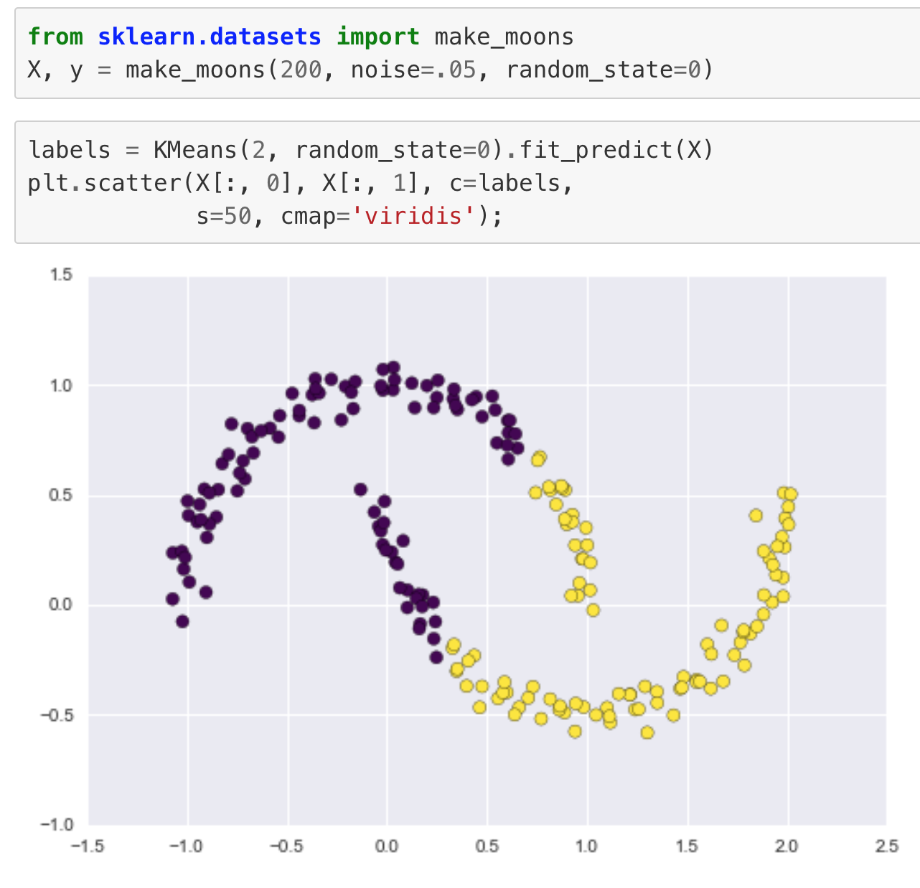
K-mean Clustering limitations
The fundamental model assumptions of k-means (points will be closer to their own cluster center than to others) means that the algorithm will often be ineffective if the clusters have complicated geometries.
In fact, K-mean usually works well for Spherical and Linearly separable data.
Here is an example →
Can’t work well, because data are not linearly separable.

Slide 10
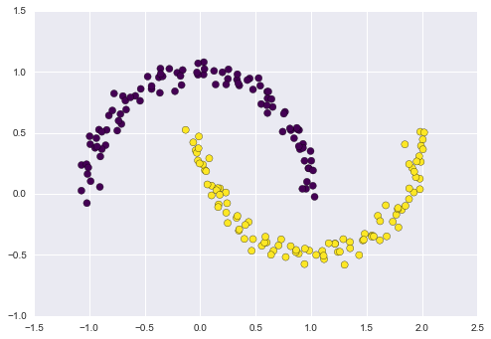
Spectral Clustering: k-means in higher dim. spaces
You already learning that non linear data can be separable in higher dimensional spaces? Good!
Spectral Clustering is a K-Mean that project the data into higher-dimensional space and then apply K-Means!

Slide 11
Feature Scaling
Be careful ! Since K-means and Hierarchical clustering uses a distance metrics, we always have to scaling the features so that they are comparable.
If not, if a features is in KM and another in Centimeters, the feature in centimeters is sort of ignored because too small!

Slide 12
Hands on session!
Open notebook clustering

Slide 13
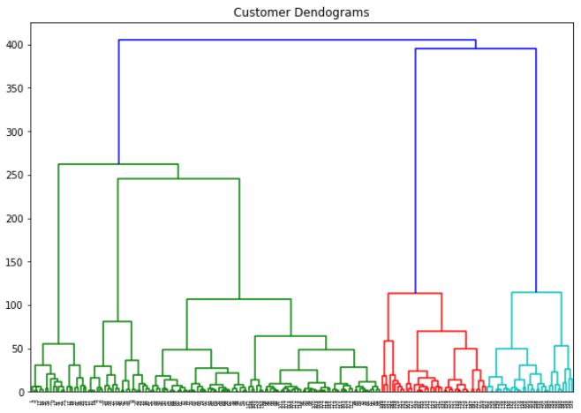
Hierarchical Clustering (Agglomerative Clustering)
This is another useful technique used often. This allows us to visually see the clusters even if we are in high dimension space. This technique create a Dendrogram.

Slide 14
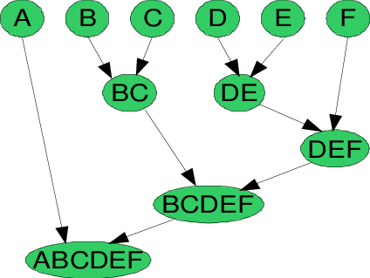
How it works?
Initially all the samples in the dataset are considered single clusters.
Then it is an iterative process:
Calculate distances: Calculate the matrix distance (distances between all pairs of samples)
Merge: merge into 1 cluster the closest pair of samples
Repeat until there is only 1 big cluster.
https://towardsdatascience.com/understanding-the-concept-of-hierarchical-clustering-technique-c6e8243758ec

Slide 15
What is a dendrogram
It is a way to visually see the number of cluster and evaluate the distance between samples.
How?
On the bottom we have ALL the samples in the dataset.
The vertical lines indicate the distance between clusters

Slide 16
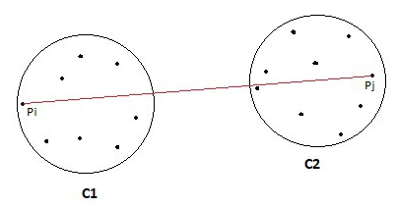
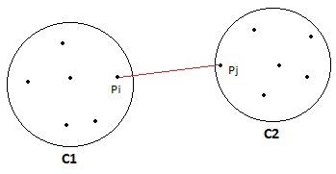
The Distance between clusters in Hierarchical
Min = the distance between 2 clusters A and B is the minimum distance between 2 samples in A and B
Max = the distance between 2 clusters A and B is the maximum distance between 2 samples in A and B

Slide 17
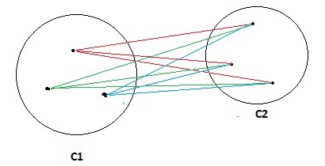
The Distance between clusters in Hierarchical
Average = the distance between 2 clusters A and B is the average distances between all pairs in A and B
Wards = the distance between 2 clusters A and B is the sum of squared distances between samples of A and B. It is similar to Average
To know better the pros and cons of each distance criteria start here: LINK

Slide 18
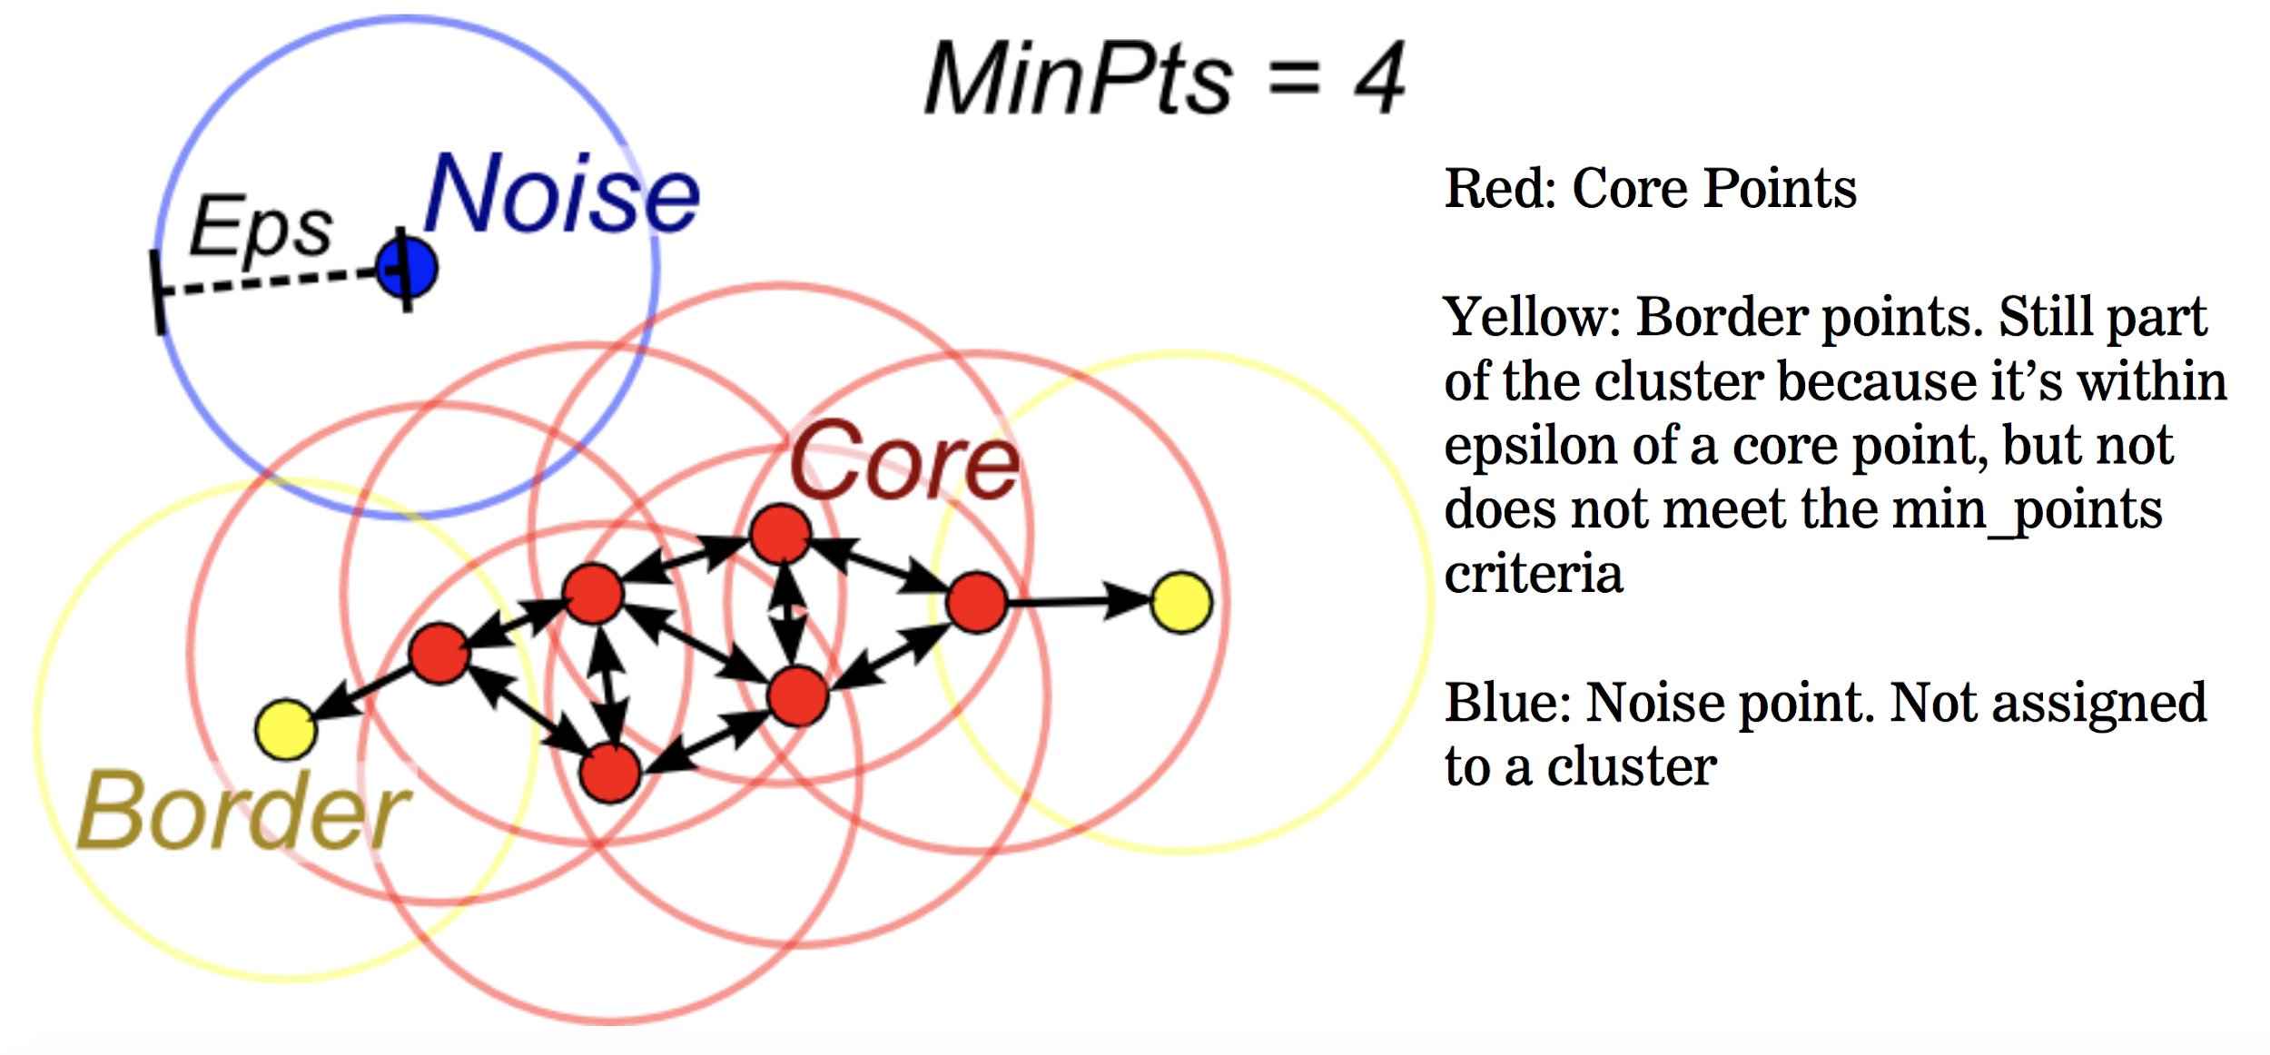
DB Scan
This clustering is based strong when there is noise in the dataset.
LINK

Slide 19

What to know about Clustering
The most well known clustering techniques are K-Means and Hierarchical clustering. KMean belongs to the category “Centroid-based clustering” while Hierarchical belongs to the category “Connectivity-based clustering”.
Both works on iterative processes.
K-Means works well with spherical data and linearly separable data. To understand the number of clusters we can use the Elbow Method.
Hierarchical is an agglomerative bottom-up clustering (from single samples until 1 big cluster) and it generates a dendrogram: here is more easy to understand the number of cluster, visually.
All the clustering techniques work with distance metrics.
DBScan is a density based technique, that is particularly strong in case of NOISE dataset since the clusters are formed when they reach a certain density (number of point in a space unit = density)

Slide 20
Dimensionality Reduction
Principal Component Analysis

Slide 21
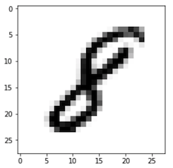
Dimensionality Reduction
In general dimensionality reductions are techniques to transform the samples into a lower dimensional space. For example from samples living in 64 dimensions into a space with 10 dimension.
The goal is preserving the quantity of information in the samples but projecting in a lower space.
Examples?
If we drop some white pixels around the 8 number, we don’t probably lose much useful information.
Also, the black pixels are highly correlated one with the adjacent you.
Hence, probably some information can be dropped without losing much information

Slide 22
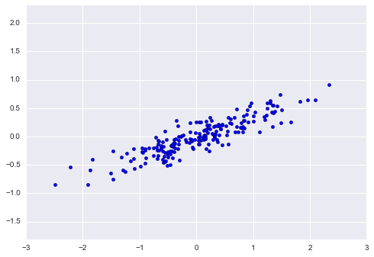
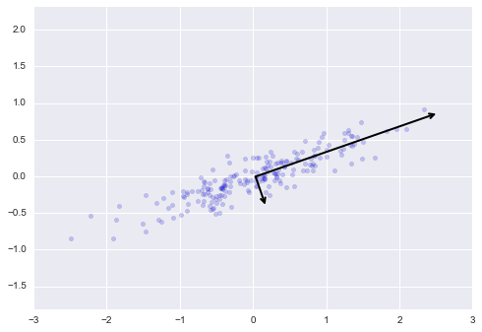
Change of basis describing the data
Here the samples can be described in terms of Z1 and Z2. These new vectors Z1 and Z2 are the principal components
X2
Z1
Z2
X1

Slide 23
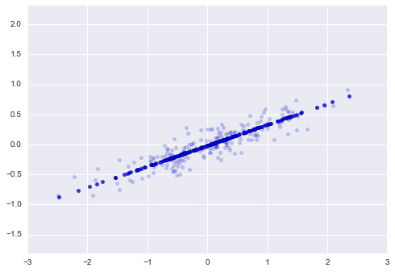
Change of basis describing the data
Z1
Z2
PCA is able to find the directions of maximum variance in data and project data along this direction. Think about variance as “information quantity”. Notice that Z2 direction is much smaller than Z1 direction. We can describe data ONLY along Z1.

Slide 24
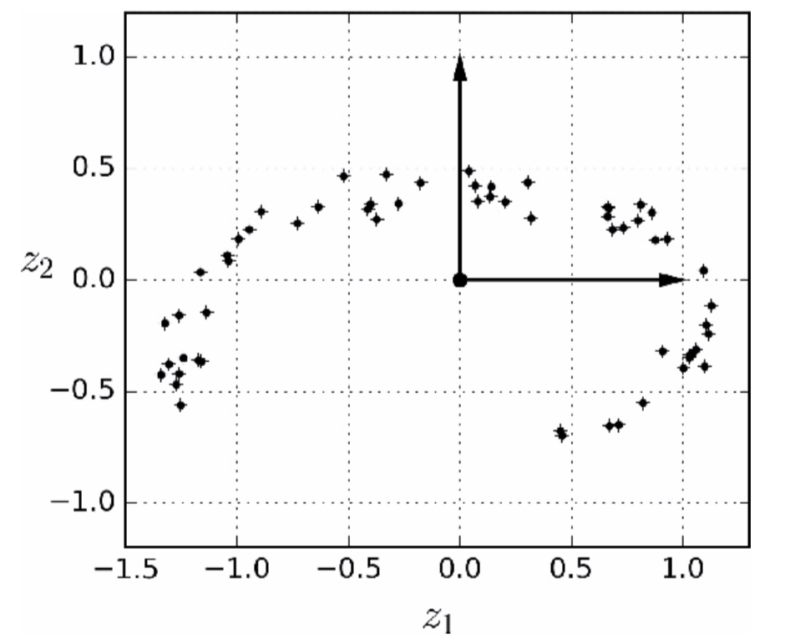
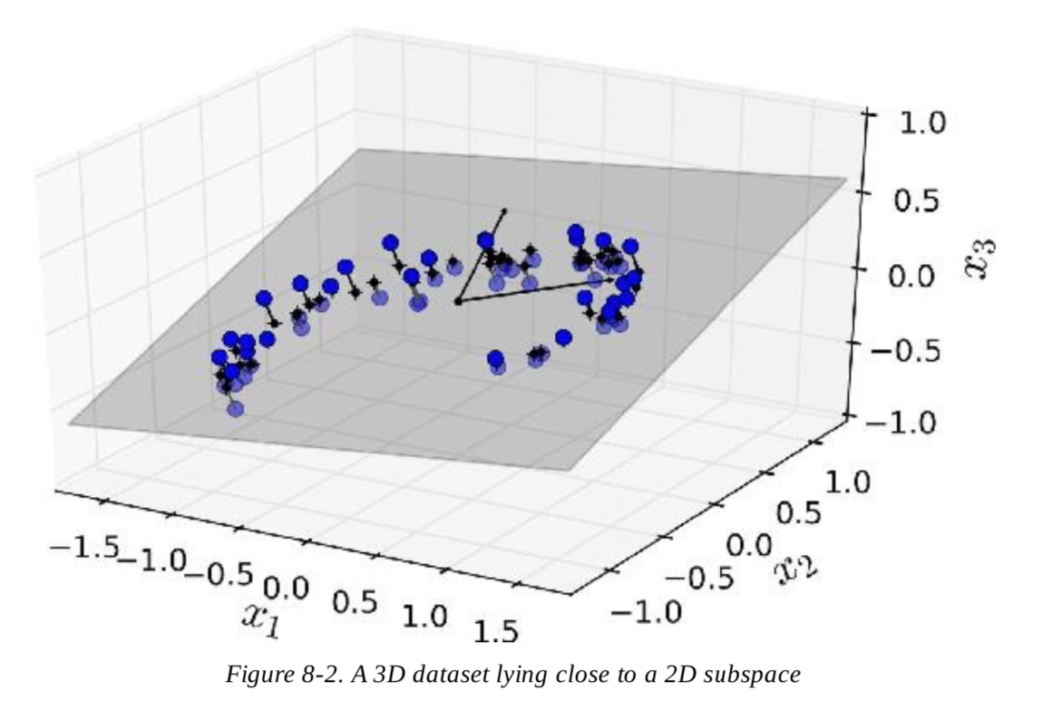
3D example
In this example, 3D data lies close to a plane. We can then project the 3D data into on the plane and change vector basis.

Slide 25
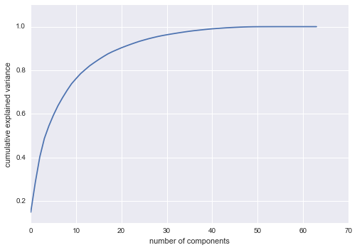
How much information retained?
This is a very common plot: this depicts the information retained (from 0 to 100%) depending on the number of components used.
This means: using 20 components we are able to describe the data losing about 15% of the information in the data.

Slide 26
What is PCA?
Principal component analysis is a dimensionality reduction technique used to preserve the information in the data BUT mapping the samples in a lower dimensional space.
This is done by finding the “directions of maximum variation” (that are supposed to have much information) and projecting the data along these directions.
These are “privilege directions” called Principal Components that describe the information content of the data.
More precisely the directions are vectors called “Eigenvectors” and the “power” in each of these is called “EigenValues”
(Yes, if you know Linear Algebra, this sounds like getting the EigenVectors and EigenValues of a matrix...in fact it is like that! But the matrix is the covariance Matrix).

Slide 27
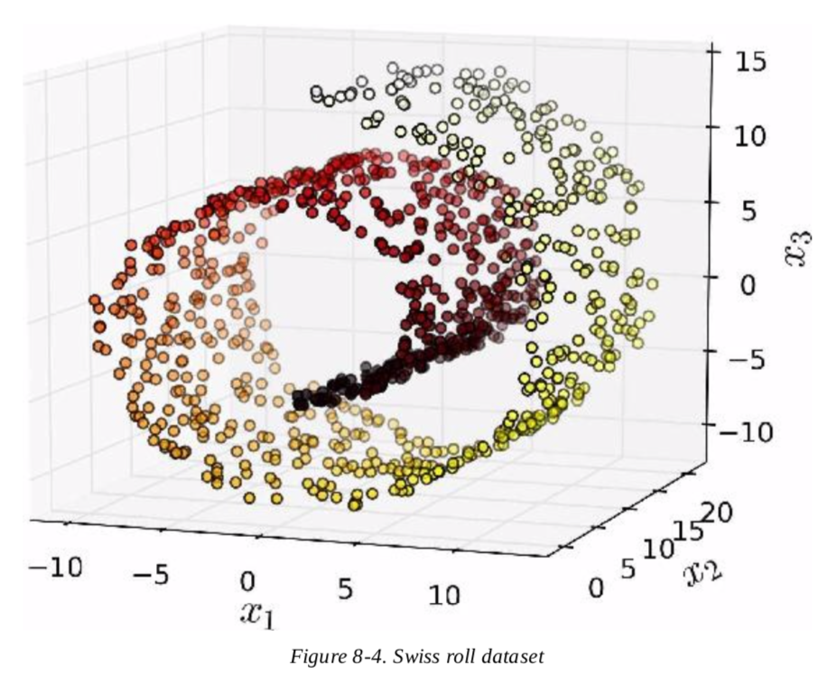
Why PCA is used?
It can be used for:
Speed up model Training (since we have less features)
Compress dataset and images
Denoising of images
Project dataset into 2 dimension and plot samples (to understand possible clusters)
Be careful! PCA can detect only project data into linear structures (rect, planes…) because data are linear.
If data are nonlinear, you need to use Manifold algorithms.
Not covered in this course but here a very good link
LINK
LINK to a very cool exercise about images!

Slide 28
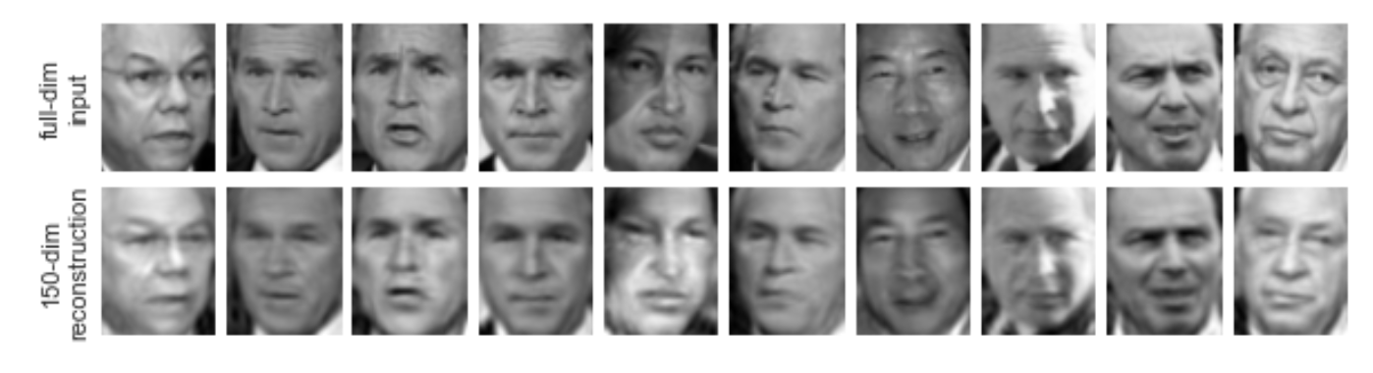
LINK to a very cool exercise about images!
COMPRESSION OF IMAGES

